Slide 1


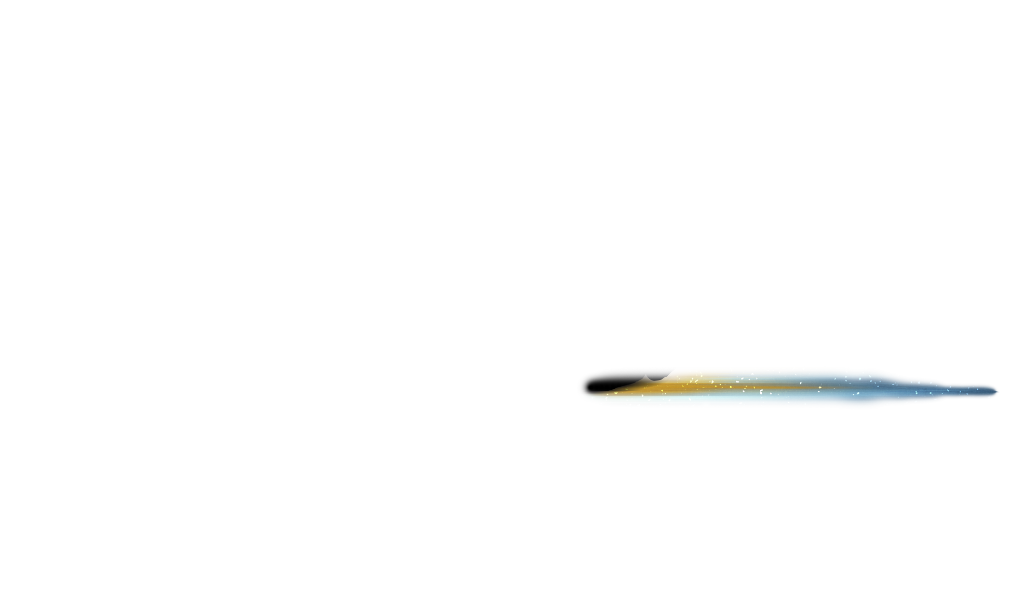










7 Sales Accelerators

Slide 2



Do or die

Slide 3


Compelling Value
Urgency
Risk Needs

Slide 4

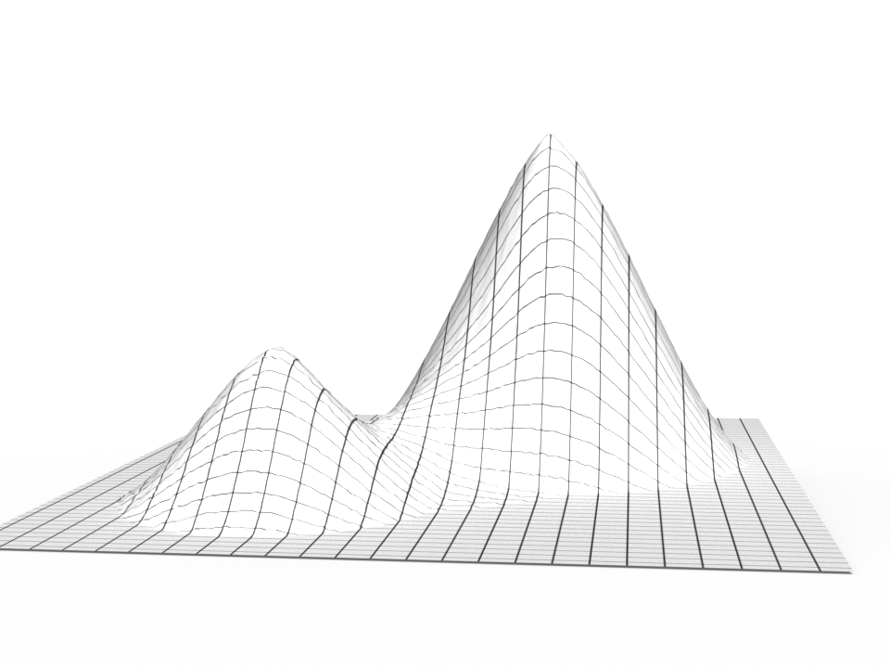

To help customer achieve
Highest value
Avoid a 2nd best solution
Optimal
2nd best

Slide 5

Customization of the Call

Slide 6



Committed Position – going “all in”

Slide 7



Disruptive Selling

Slide 8

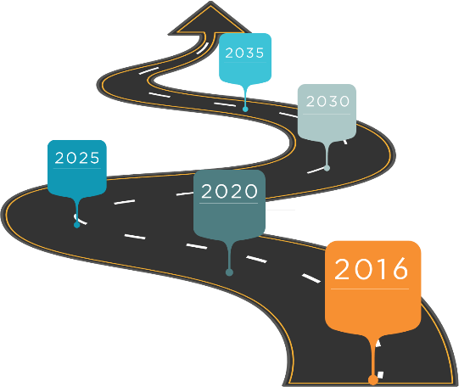
Escalation to real DM
Owner/higher
Level exec
Buyer
If we don’t talk to the right person…

Slide 9


Critical danger – confirmation bias
NO
NO
NO
NO
NO
NO
NO
NO
NO
NO
NO
NO
NO
NO
NO
NO
NO
NO
NO
NO
NO
NO
NO
NO
NO
NO
NO
NO
NO
NO
NO
NO
NO
NO
NO
NO
NO
NO
NO
NO
NO
NO
NO
NO
NO
NO
NO
NO
NO
NO
NO
NO
NO
NO
NO
NO
NO
NO

Slide 10




Mindful selling
Thoughtfulness.
Listening.
Learning.
Beginner’s Mind.

Slide 11

With Sales Accelerators

Slide 12

Results in more sales, sooner

